Slide 1
DDD anche nei Dati? (AKA Data Mesh)

Slide 3
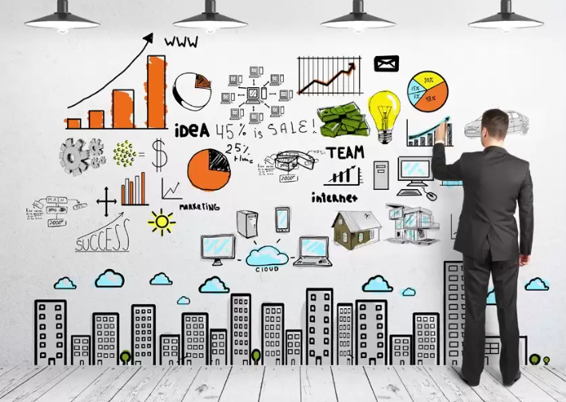
All we need is Data!

Slide 4
NewVantage Report
Have a data culture
27 %
Become data-driven
38 %
Competing on data
45 %
Investments > $50
65 %

Slide 5
Failure Symptoms
Fail to bootstrap
Fail to scale sources
Fail to scale consumers
Fail to materialize Data-Driven value

Slide 6

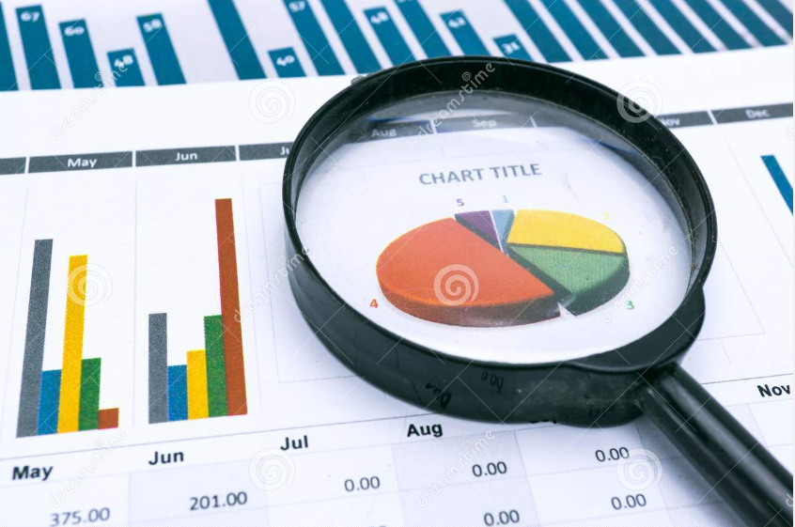
Operational vs Analytical
Operational
Analytical
E
T
L

Slide 7
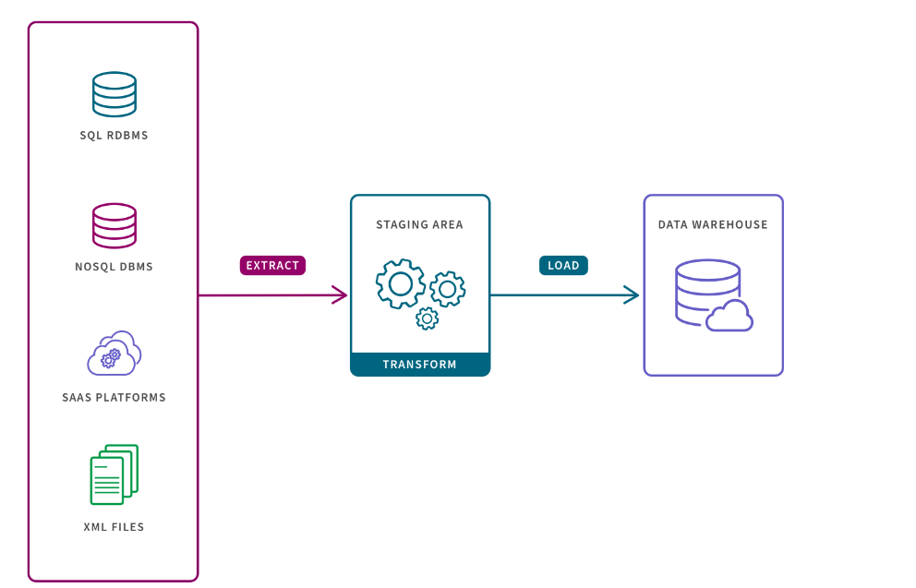
Misintegration

Slide 8
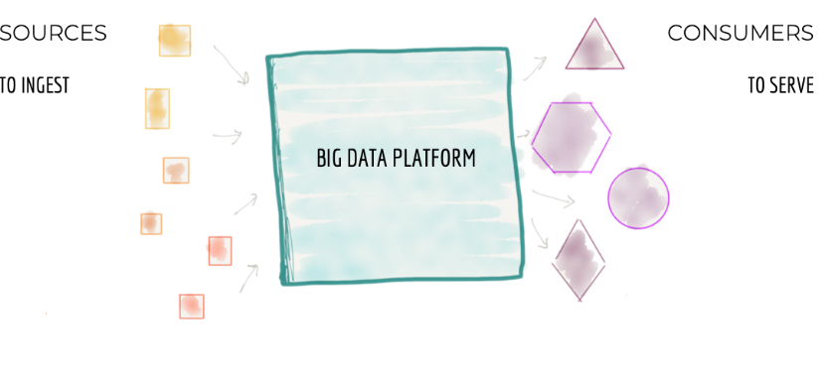
Centralized Monolithic

Slide 9
Decomposition
INGEST
FEATURES
AGGREGATE
CAPABILITIES
SERVE
Scale Architecture with top-level technical partitioning
Architecture decomposition orthogonal to change

Slide 10
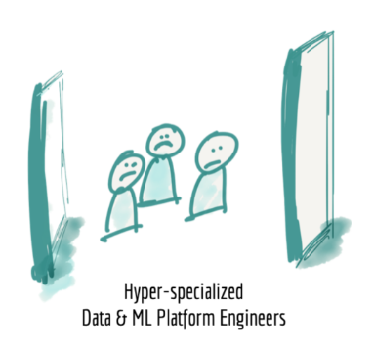
Hyper-specialized silos

Slide 11
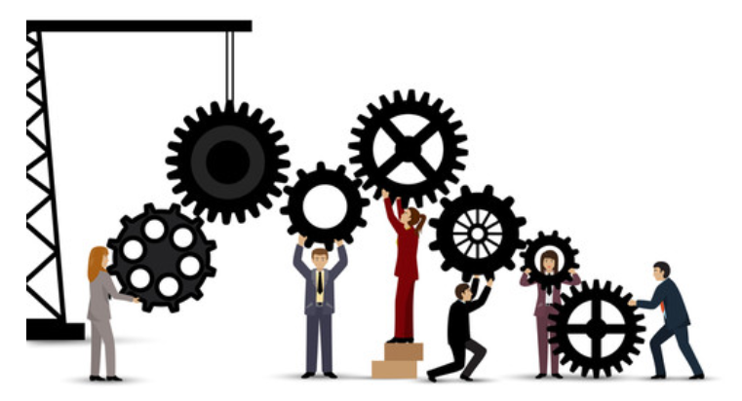
Disconnected

Slide 12
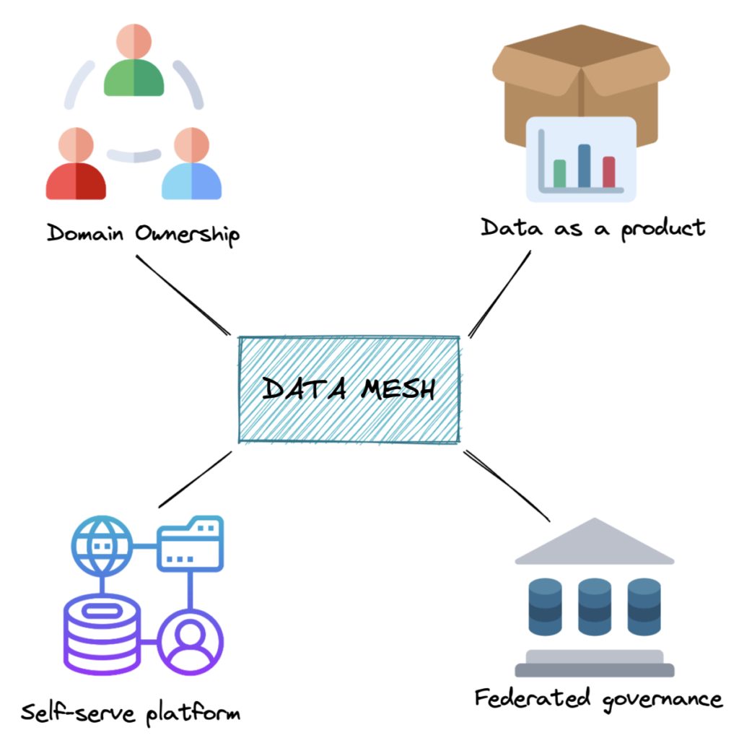
Data Mesh (Zhamak Dehaghani)

Slide 13
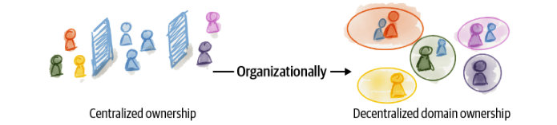
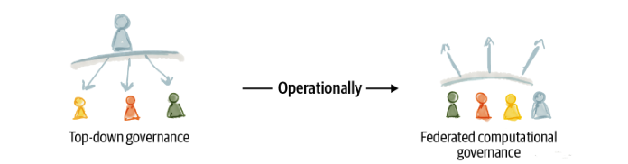
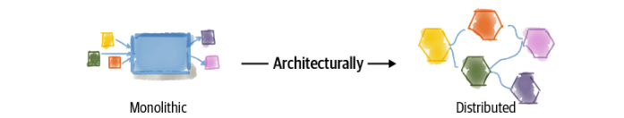
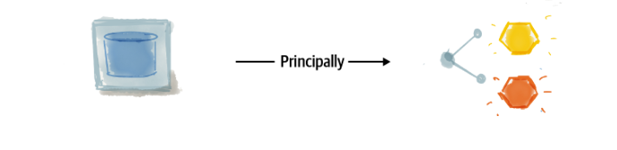
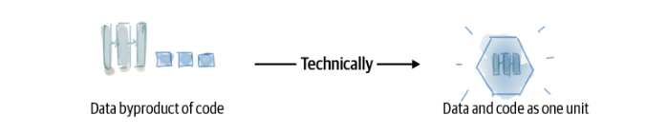
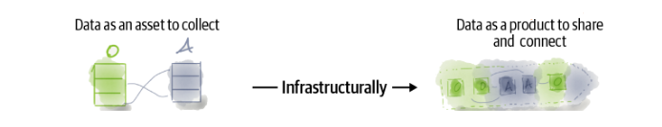
Data Mesh as a socio-technical approach

Slide 14


Domain-Driven Design

Slide 15
Pattern Strategici
Pattern Tattici
Ubiquitous Language
Entity
Bounded Context
Value Object
Context Mapping
Aggregate
Aggregate Root

Slide 16
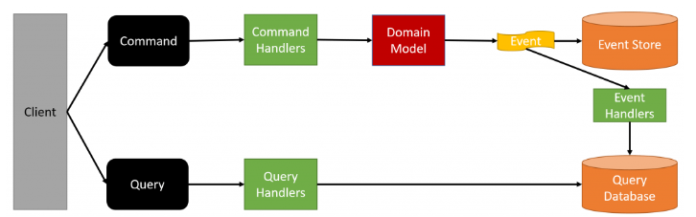

CQRS + ES
CQRS and Event Sourcing Introduction – Greg Young

Slide 17
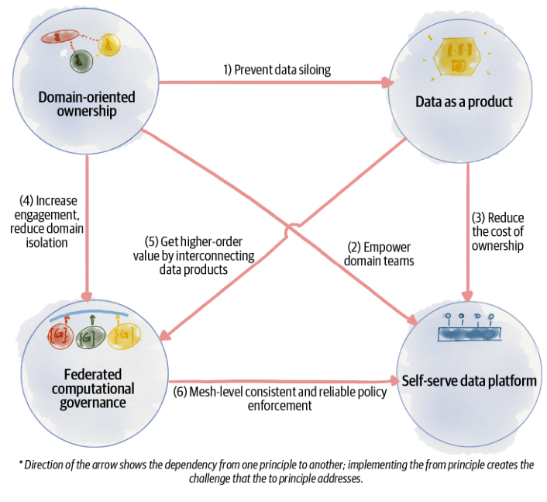
The Principles

Slide 18
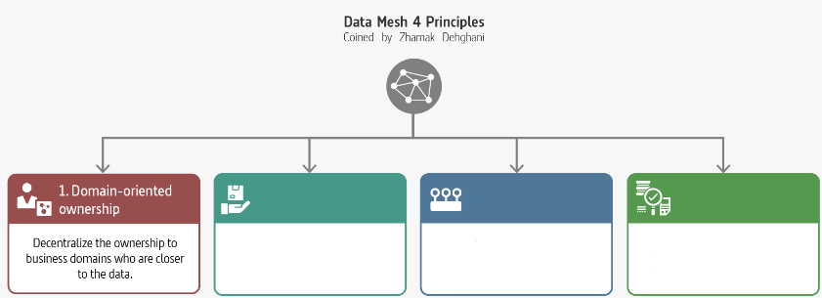
Domain-Oriented Ownership

Slide 19
Decompose Data Around Domains
Domains aligned with the origin of data
Domains aligned with the consumption
Domains aligned with shared aggregates
Distributed the ownership

Slide 20
Transformation to Domain-Oriented Data
Flowing data
Serving data at the source
One canonical model
Multiple models
The source of truth
The most relevant copy
Pipeline as a first-class concern
Domain’s internal implementation
Technology-driven decomposition
Domain-oriented distribution

Slide 21
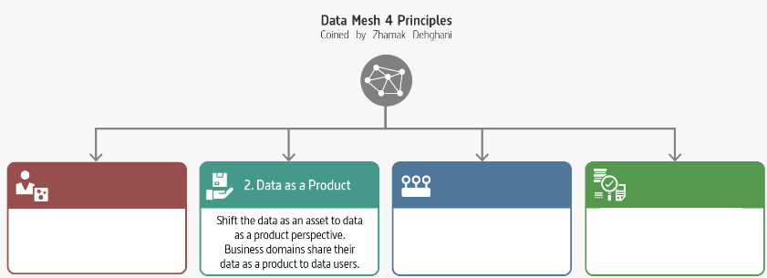
Data as a Product

Slide 22
A Succesful Product
Usable
Discoverability
Trusthful (trustworthy)
Interoperable
Valuable
Understanding
Natively Accessible
Feasible
Marty Cagan «Inspired»
Don Norman «The design of every day things»
«A confident relationship with the unknown» Rachel Botsman

Slide 23

Data as a Product
Code
Data Product
Polyglot Data
Infrastructure

Slide 24

Data Product Owner

Slide 25
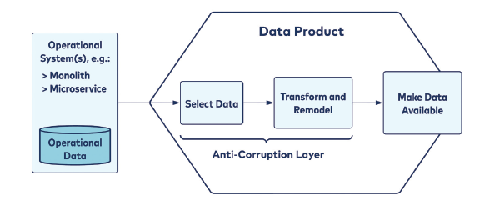
Domain Boundary

Slide 26
Building a Data Product
Facts are read-only
Only the data product owner can add new facts to the data product.
Facts are immutable
Data product owners can append new facts as an addendum to previous facts, but cannot modify, overwrite, or delete them
Facts are timestamped
Each fact contains a timestamp representing when it occurred, such that time-based ordering is made possible

Slide 27
Transformation to Data as a Product
Data as an asset
Data as a product
Byproduct
Product
Data as an output of compute
Data and compute as one unit

Slide 28
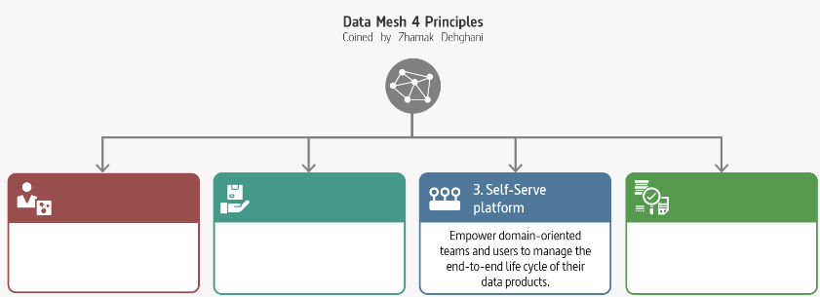
Self-serve Data Platform

Slide 29
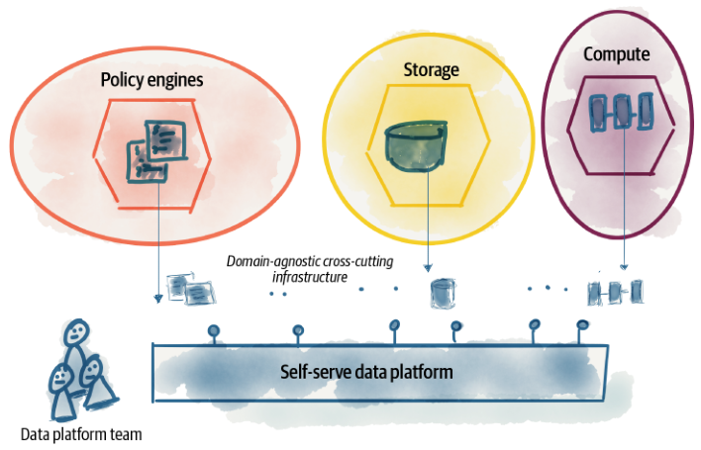
Self-Serve Data Platform

Slide 30
Logical Architecture
Mesh Experience
Data Product Developer
Data Infrastructure

Slide 31
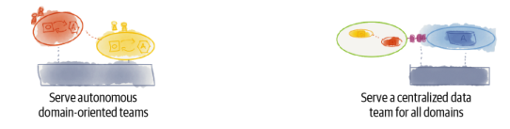
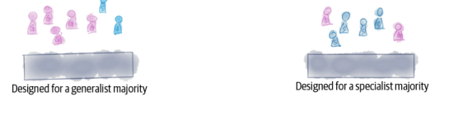
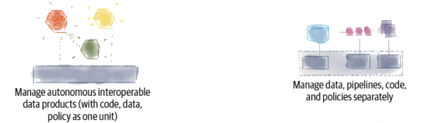
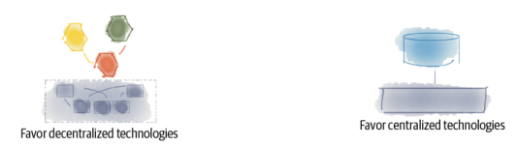
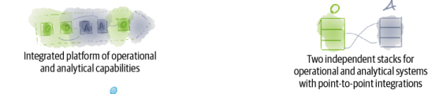
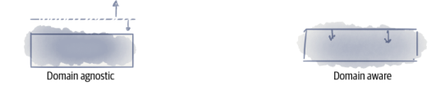
Data Mesh vs Others
Data Mesh
Others
Data Mesh
Others

Slide 32
Transformation to Self-Serve Data Platform
Big platforms
Protocols
Specialists
Enthusiasts/Generalist
Imperative
Declarative
Mechanisms
Experiences

Slide 33
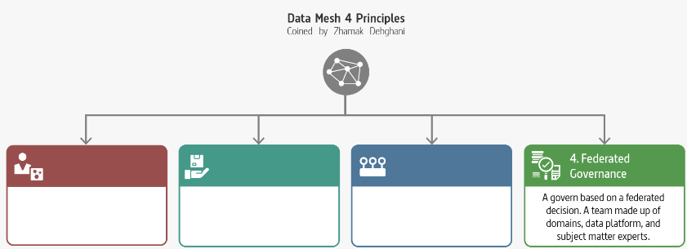
Federated Computational Governances

Slide 34
Federated Computational Governance
Decentralization and domain self-sovereignty
Interoperability through global standardization across data products
A dynamic topology
Automatic exection of decisions and policies by the platform
Maintains equilibrium between centralization and decentralization

Slide 35
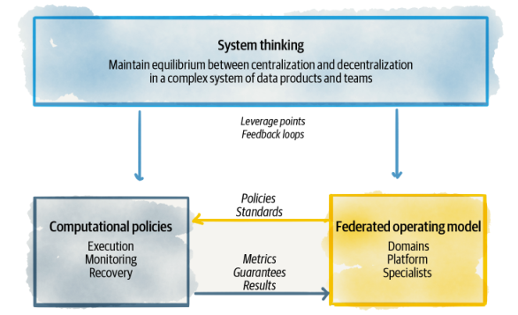
Equilibrium

Slide 36
Transformation to Federated Computational Governance
Centralized team of data experts
Federated team of domain owners and subject matter experts
Responsible for data quality
Responsible for defining what constitues quality
Responsible for data security
Responsible to define aspects of security
Responsible for canonical data modeling
Responsible for modeling polysemes
Measure success based on volume of data
Measure success based on value generated through network effect of the mesh-consumption of data

Slide 37
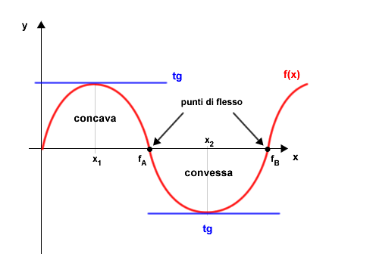
Why Data Mesh?

Slide 38

You hear that Mr. Anderson? That is the sound of inevitability …

Slide 39
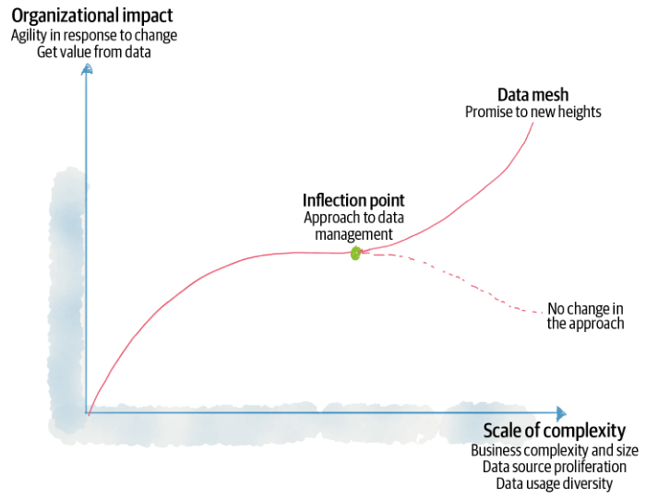
Data Mesh inflection point

Slide 40

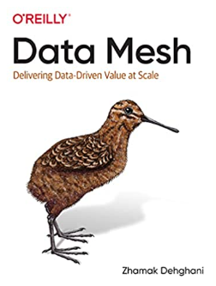
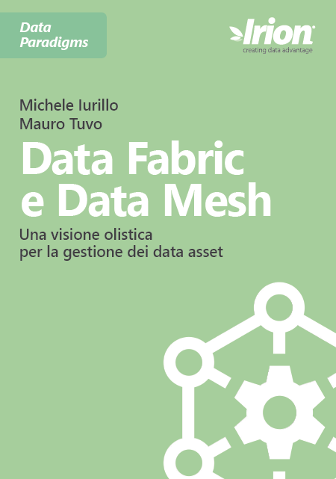



References
Zhamak Dehghani
Introduction to Data Mesh
Data Fabric and Data Mesh
Martin Fowler
Data Mesh Principles and Logical Architecture
Practical Data Mesh

Slide 41









alberto.acerbis@intre.it
https://github.com/brewup
https://github.com/cqrs-muflone
https://github.com/ace68
https://www.twitch.tv/dddbrewup

